Slide 1

HOW DO YOU FEEL? (Actually, we’ll be the judge of that)
Presented by Nasim Obeid, Carly Stair, and Desmond Turner
Notes:
Hi, thanks for watching our presentation!

Slide 2
THE TASK
Facial emotion recognition (FER)
Determining emotion of a human subject based solely on facial features/expression in an image or video
Applications in public safety, healthcare, marketing and product development, and robotics
Notes:
For our computer vision task, we selected facial emotion recognition. The goal of facial emotion recognition, or FER, is to classify a static image or video of a human based on the emotion indicated on their face. FER has applications in public safety, such as preventing fatigued driving, or identifying angry passengers, healthcare (or anywhere that assessing comfortability is important), and even the enhancement of human understanding in robots.

Slide 3
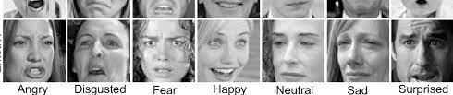
THE DATA
FER-2013 (Kaggle)
35,685 48x48 images grouped into the following emotions:
(0=Angry, 1=Disgust, 2=Fear, 3=Happy, 4=Sad, 5=Surprise, 6=Neutral)
Grayscale, scaled and centered, but pixelated
Unspecified labeling method
Notes:
We utilized the FER-2013 dataset retrieved from Kaggle. This dataset consists of over 35,000 48x48 grayscale images grouped into seven emotion classes: anger, disgust, fear, happiness, sadness, surprise, and neutral. As you can see, the images are for the most part scaled and centered. We are dealing with a bit of pixelation which will be handled in pre-processing. It’s also important to note that the labeling method was not specified for this dataset.

Slide 4
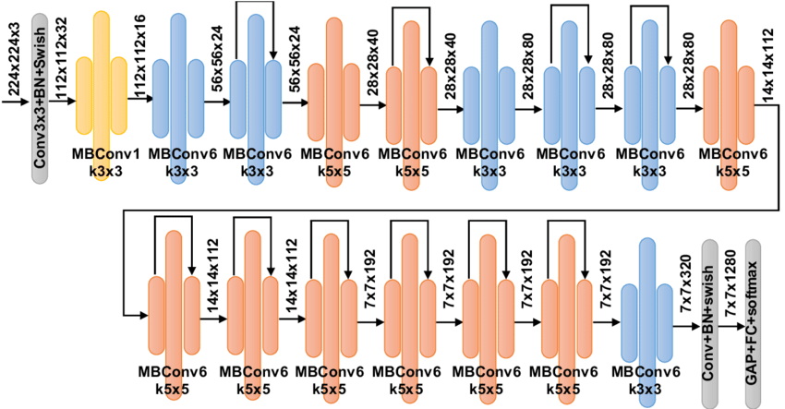
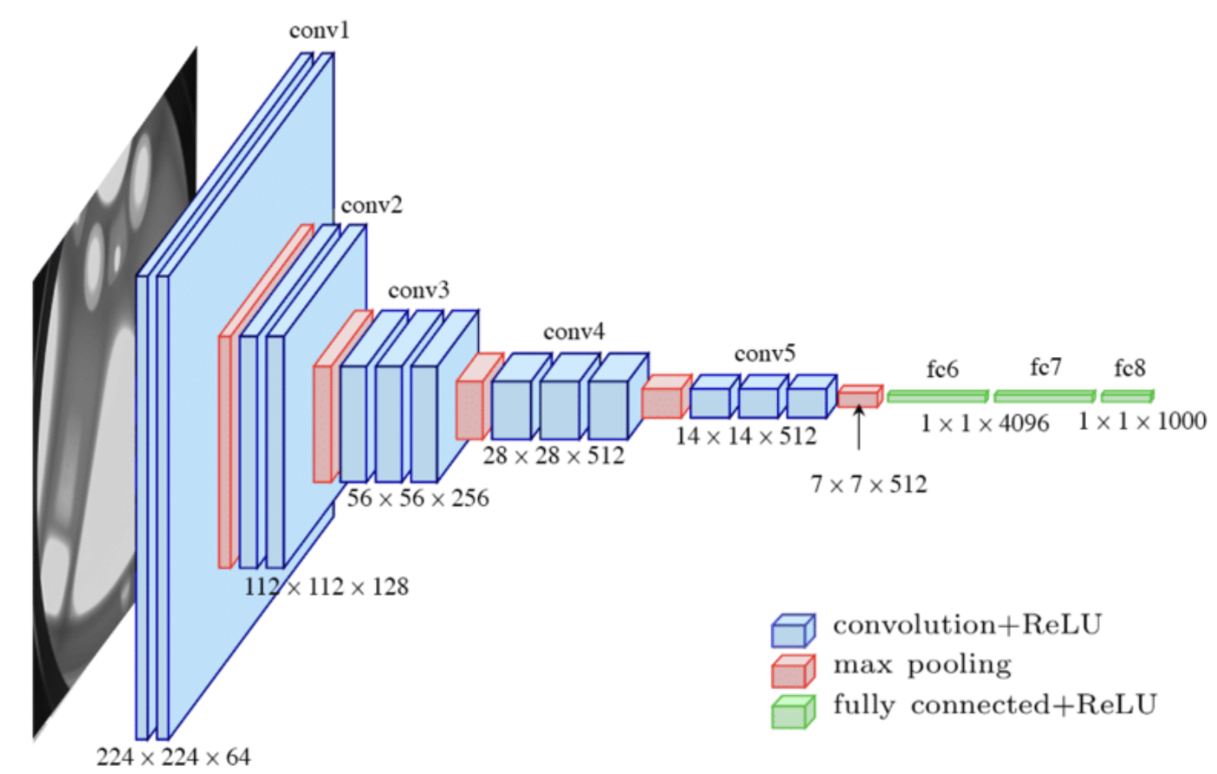
THE MODELS
EfficientNet-B0
VGG-16
Notes:
For their efficacy on image classification and other CV tasks, we compared the use of two CNN architectures: EfficientNet-B0 and VGG-16. Examples of these architectures are shown here. For a more detailed look at the resulting models, over to Nasim and Desmond!

Slide 5

THE MODELS CONT.
EfficientNet-B0 Walkthrough
VGG-16 Walkthrough
Both Models found in https://github.com/teamnassim/AAI-521-Final-Project/tree/main

Slide 6
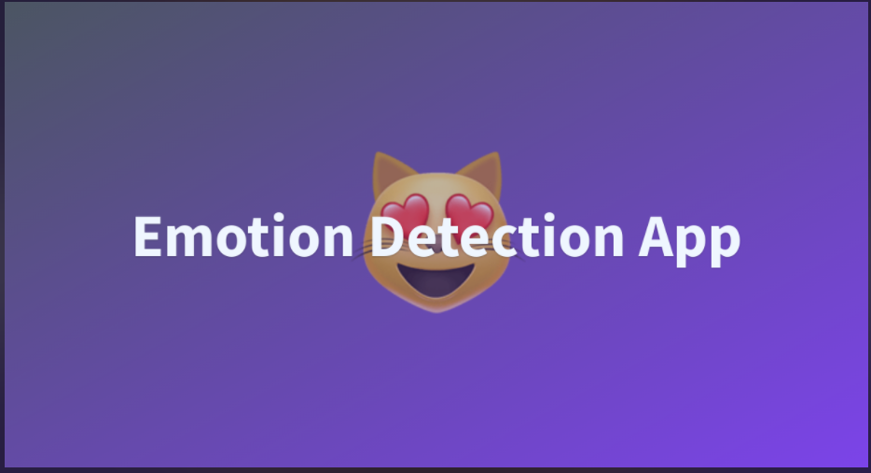

THE PRODUCT
Deployed with Hugging Face
WEB APP https://huggingface.co/spaces/teamnassim/emotion-detection-app
Notes:
We’ve created an interface using HuggingFace to put the results of our EfficientNet model to the test. By simply dragging or uploading an image, we’re presented with the predicted present emotions ranked by likelihood. This human definitely looks fearful to me!

Slide 7
THE NEXT STEP(S)
“Fair” accuracy consistent with other works of FER
Testing on additional architectures (vanilla CNN, ResNet, SVM)
Larger, more robust dataset with more context around labels
Removal of neutral subset for more nuanced detection around “stronger” emotions
Implementation for customer satisfaction, furthering understanding for non-verbal individuals, empathetic healthcare procedures
Notes:
At first glance, we might not be thrilled with our 64% accuracy. However, as discussed by Nasim, this metric is not far off from other accomplishments of automated facial emotion recognition. This is not super surprising when we consider the nuances of displaying and interpreting emotion. For further investigation on FER, we’d want to test additional architectures. A suspected pitfall of our model was the training data utilized. More quality, labeled data with better context around the choices for labels would be a great start. We encountered a fair amount of false “neutral” predictions, so we thought it might also be wise to remove this class to see if accuracy on other classes can be improved. Once harnessed, FER technology can be utilized across domains to better our human understanding, and that of our machines.

Slide 8
THANK YOU!
Notes:
Thank you!

